Slide 1






COMMUNITY INTERPRETING AND LANGUAGES OF LESSER DIFFUSION: THE ERASMUS+ PROJECT DIALOGOS.
CARMEN PENA DÍAZ
CANDELAS BAYÓN CENITAGOYA

Slide 2

Introduction
Community Interpreting (CI): takes place in social settings to enable access to Public Services to individuals who do not speak the dominant language of the host society (Hertog, 2010)
Languages of Lesser Difussion:
  ad hoc interpreting
  not always possible to provide services for all languages at all times.
CI settings
  Social settings
  Healthcare
  Legal-administrative
  Educational
  Etc

Slide 3





Languages of Lesser Diffusion (LLDs) & ad hoc interpreting
LLD: Languages for which it is more difficult to find support in the form of written information materials, mediation resources, interpreters, etc. in a given geographical area (DIALOGOS)
Needs regarding LLDs change overtime and in accordance to migratory flows over different territories (Salaets et al., 2016)
Ad hoc interpreting: takes place in a context where it is not possible to provide language services in a convential way due to socioprofessional, socioecomic, geopolitical reasons (Boéri, 2012)
In this vein, the notion of Languages of Lesser Diffusion (LLDs) becomes a rich framework against which to analyse CI, and the relationships established between its participants, including power imbalances.
  communication barriers
  impact on Public Service access
  vulnerability of migrant populations

Slide 4





DIALOGOS: Erasmus+ Project
Participants
Co-funded by the European Union
Study of LLDs and CI practices in southern European countries.
  Spain, Italy, Greece
  Challenges related to migration and language service provision specific to those territories
University of Alcalá
University of Genoa
Aristotle University of Thessaloniki
Spain
Italy
Greece
2022-2025
Abrazando Ilusiones
San Marcellino Association
Major Development Agency Thessaloniki
Spain
Italy
Greece

Slide 5


DIALOGOS: Erasmus+ Project
Objectives for today
WP2
the mapping of linguistic needs across the three southern European countries (Spain, Italy, and Greece)
suveys & interviews with stakeholders
OBJECTIVE:
  identify LLDs in the 3 countries
  identify communication needs
  create materials to palliate the gap
  creation of an open-access online training course in translation and interpreting in Public Services for LLD speakers who typically act as non-professional interpreters.
  ADAPTATIVE response for a reality and its needs
    Work Packages were defined and implemented
    Highlighting the importance of providing specific training in CI, as a key aspect to achieve equal access to Public Services for vulnerable populations.
WP3
material creation
course designing
pilot course
results
WP4
online version of the course

Slide 6



Work Package 2
Networking
Surveys & interviews
Between DIALOGOS’ partners and other strategic stakeholders
Gather information about LLDs0 needs, PSIT and CI practices
18-35 y/o LLD speakers working in the field or in training
Mapping
165 students
171 professionals
24 interviews conducted
Students & professionals
Of the programs & materials currently used for PSIT or CI training in Spain, Italy, and Greece

Slide 7
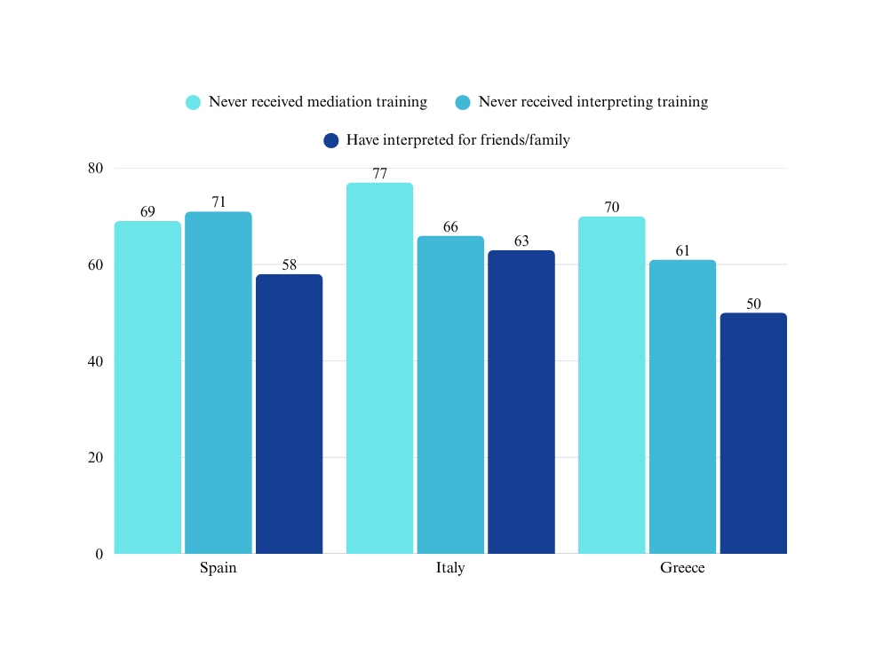
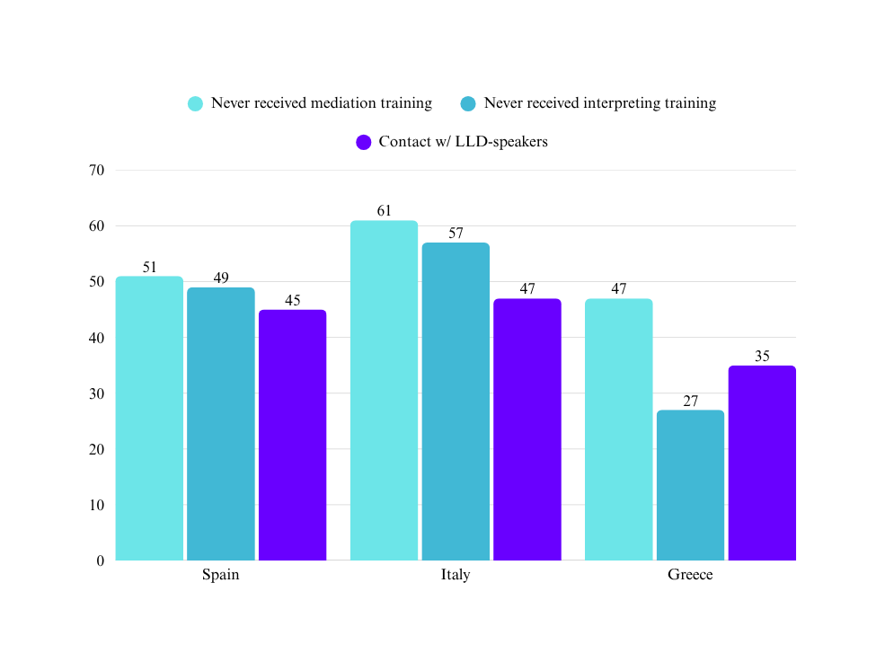
Surveys: results from students&professionals
Students (%)
Professionals (%)

Slide 8
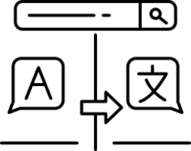
Student’s survey
LLDs spoken
Spain | Italy | Greece
Arabic (Classic, Darija, Morocco), Bambara, Bassa, Bétlé, Bromen, Bubí, Bulgarian, Bulu, French Creole, Dinla, Edo, Efik, Eton, Éwé, Ewondo, Fang, Georgian, Hassania, Ibibio, Malinke, Mondingo, Peul, Pidgin, Polish, Rifeño, Sous Sous, Swahili, Yomba, Wolof. | Albanian, Arabic (including “Tunisian dialect” as it was written in a specific answer, Morocco Arabic, specifying “Darija”), Cape Verdean Creole, Chinese (in one case out of four specifying Cantonese), Greek, Koniake, Pidgin English, Romanian, Ukrainian, Yoruba, Wolof. | Albanian, Arabic, Finnish, Romanian, Russian, Sinhala, Tamil.

Slide 9
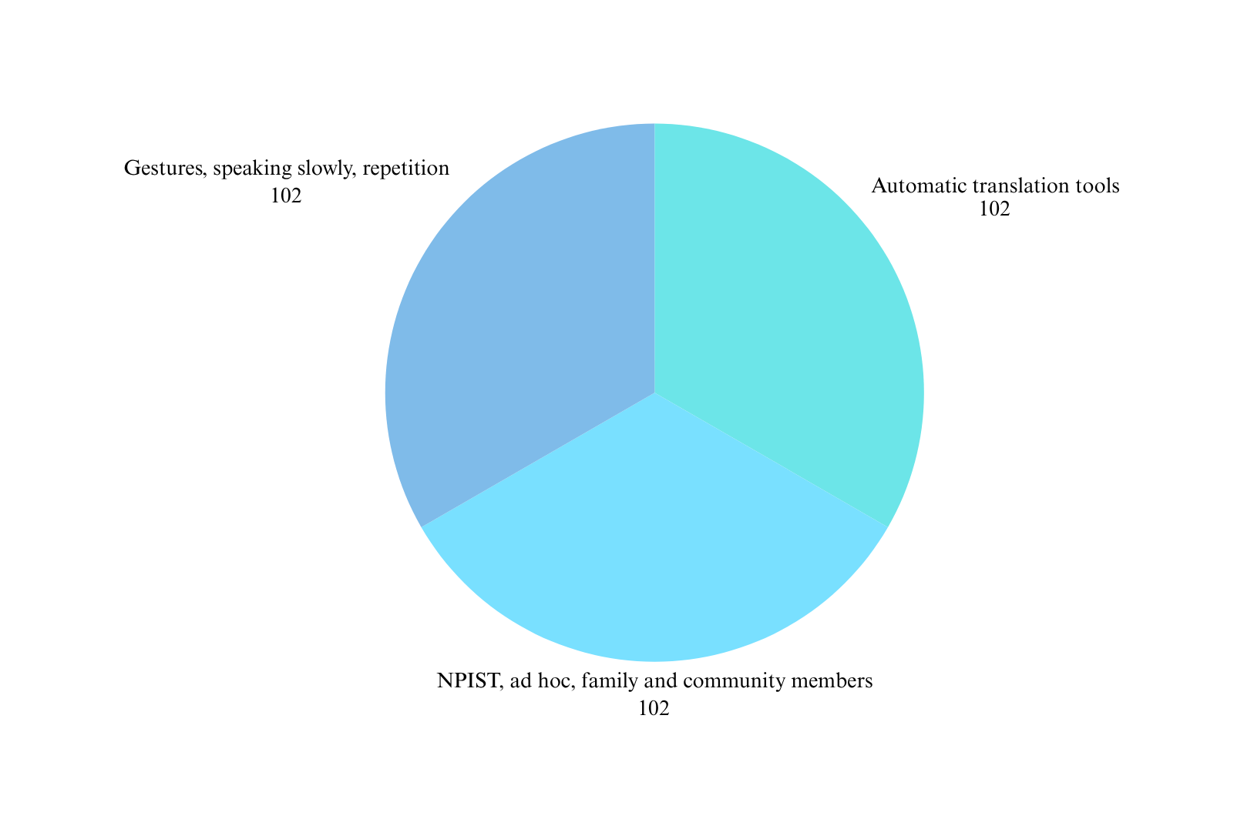
Professional’s survey
Least effective strategies

Slide 10

  Professional’s survey
  Most effective strategies
  Suggestions to improve
  Mediators, translators & interpreters
    Professional
    Certified
    State-funded
  Multilingual materials available
  Intercultural communication training for public service providers
  Language courses
  Remote interpreting
  Mediators, translators & interpreters
  Using a vehicular language
  Empathy
  Drawings

Slide 11
  Interviews
  Demographic which experiences most challenges
  Most challenging settings
  Migrant population
  Refugees
  Vulnerable population from underpriviledge backgrounds
  Illiterate population
  Legal, healthcare, and educational settings, job-related issues
  Main issues and barriers
  Contents & methodologies for the DIALOGOS training course
  Lack of knowledge of the setting procedures
  Difficulty in accessing PSIT/lack of PSIT T&I
  Prejudices, racism
  Excessive bureacracy
  Cultural/religious sensitivities
  Domestic violence
  Practical-oriented content
    roleplays
    case studies
  Collaborative learning
  Self-paced
  Terminological and psychosocial aspects should be taken into account

Slide 12
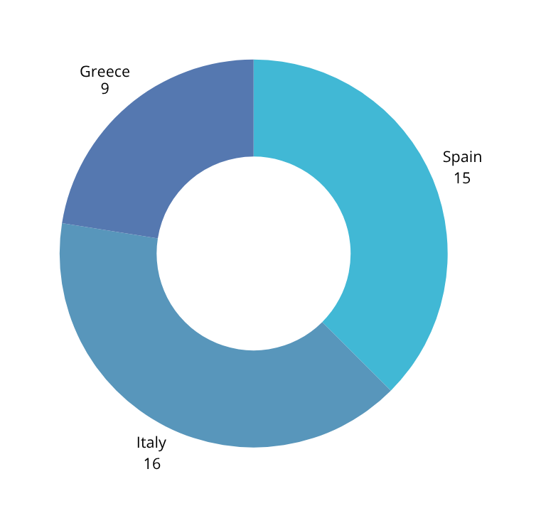
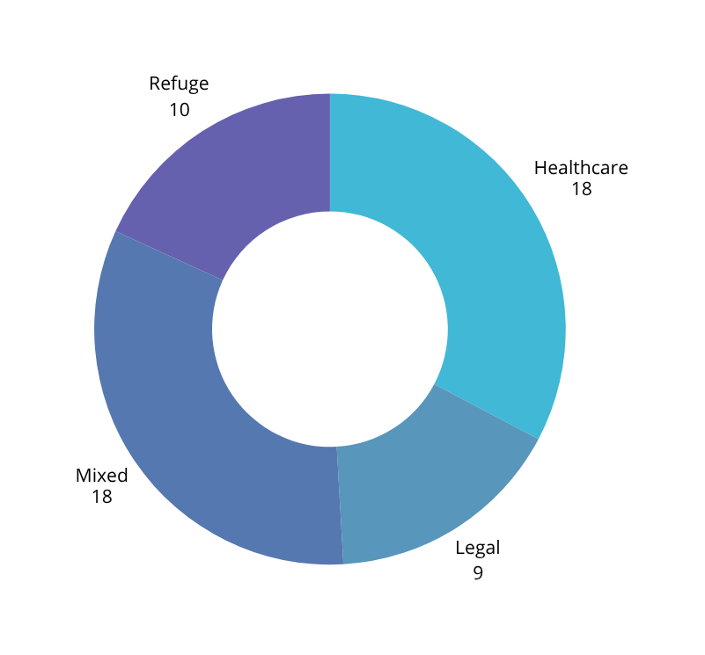
Mapping task
Material analysis & classification
Teaching programmes: 40
Materials: 55
*Mixed: humanitarian, intercultural competence, etc.

Slide 13


  Results from WP2: State of the art so far
  LLDs as an area where ad hoc interpreting is common
  High percentages of Public Service professionals not trained in intercultural communication
  Contact w/ LLDs speakers is relevant enough
  Professional, trained mediators, interpreters and translators are viewed as an effective strategy and desired option to enable communication
  Certain settings present higher communication challenges, e.g. legal-administrative. This coincides w/ the settings w/less multilingual resources & materials available
  Underrepresentation of LLDs in training programmes

Slide 14

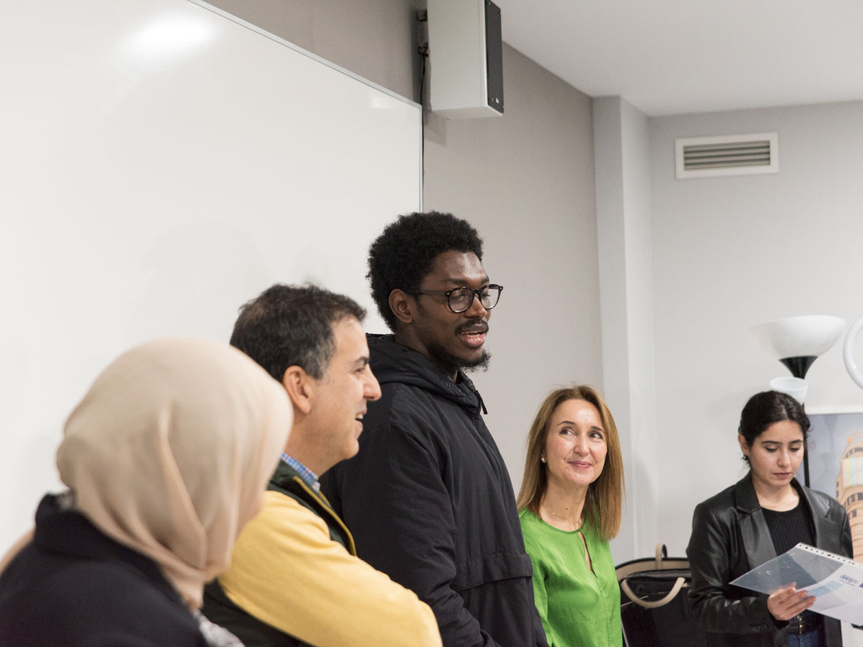


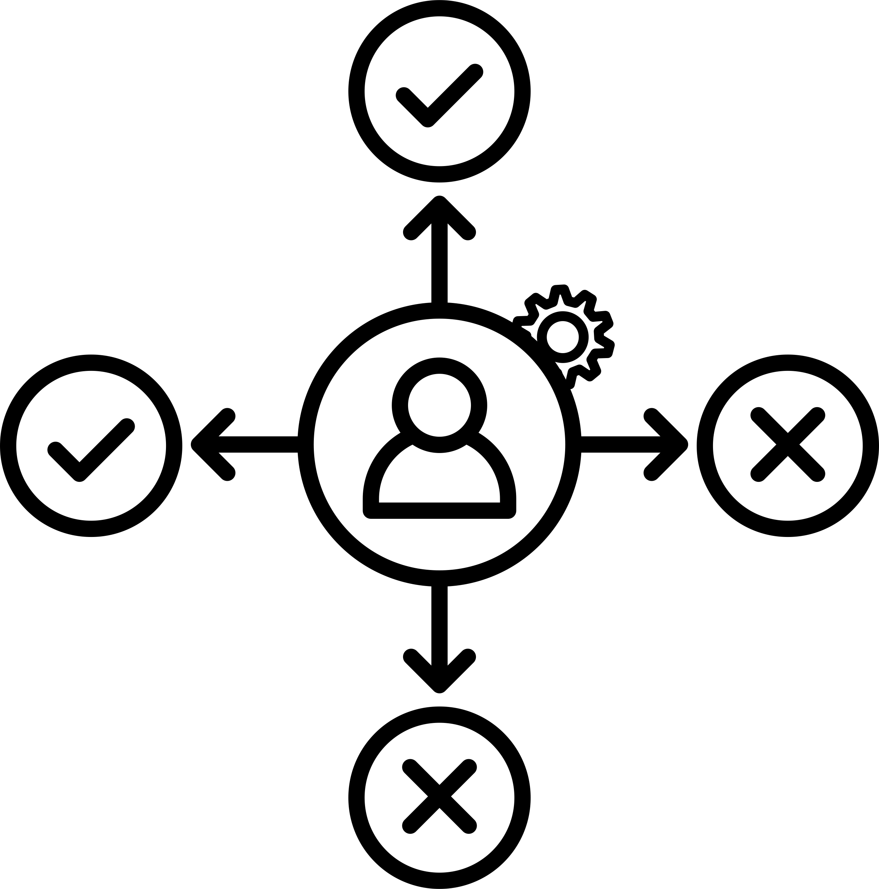
Work Package 3
Course design & material creation
To determine the final contents,making use of some of the materials gathered from the previous task and producing new ones
Material analysis
  Selection of resources, materials, programmes, etc. relevant for the development of our own course
  Analysis and classification
  (Nevado, Pelea & Bobaila, 2020)
Piloting & results
To help the development of an online training course in the final work package by analysing and assessing the effectivity and usefulness of the materials and methodologies suggested

Slide 15


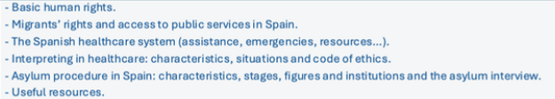


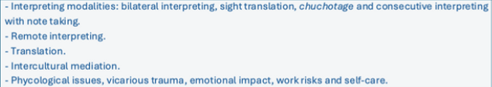

Material creation & course design
Modules 4 & 5 localised for the other countries
6 Modules:
Materials for the pilot course were in Spanish but then translated to English
1
4
What do I need to know to be able to work as an interpreter/translator/mediator?
What is PSIT?
2
Who will I be helping?
5
What do I need to know to be able to work as an interpreter/translator/mediator?
3
What will I do as an interpreter/mediator/translator?
6
What do I need to know next?

Slide 16


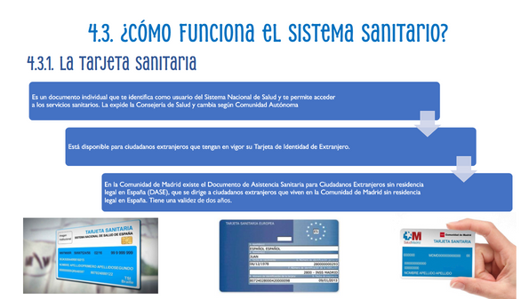
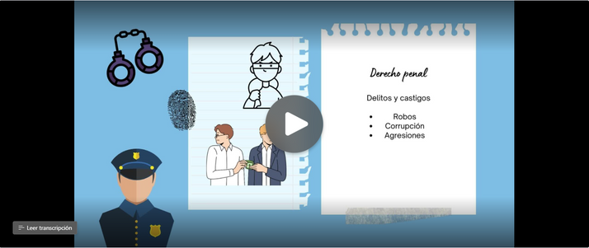
Material creation & course design
Material creation:
Introductory video
PowerPoint presentations
Roleplays
Kahoots and questionnaires for assesment
Explanatory videos about the functioning and figures of PSIT settings

Slide 17
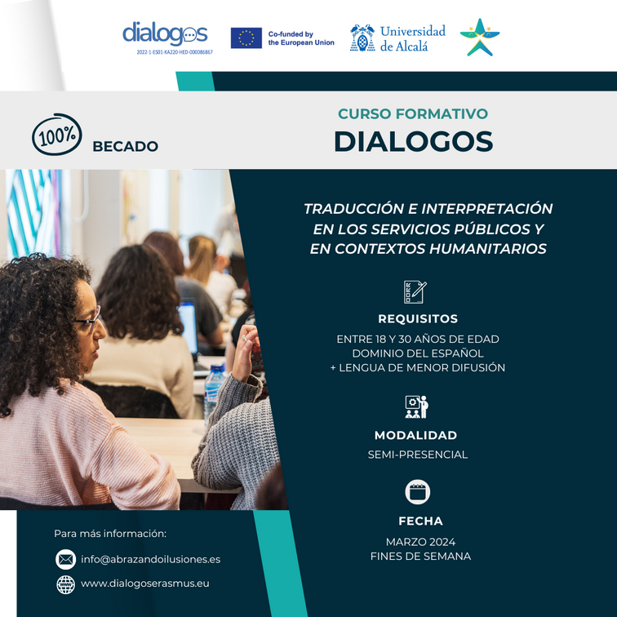
Course design & piloting
OBJECTIVE
AIMED at:
To test the materials & course created
  Bilingual & bicultural individuals proficient in at least 2 languages, 1 being an LLD
  Not necessarily w/university-level educational background or PSIT training
PROCESS
  Contacted 74 third-sector organisations who work with migrant and refugee individuals in Spain
    to identify LLD needs & language provision services state of the art
PARTICIPANT selection:
  17 participants
  18-30 y/old
LLDs spoken:
  Amazigh, Arabic (Hasania, Darija), Armenian, Bambara, Bassa, Diula, Chinese (Mandarin + Wu and Northern Eastern dialects), Ewondo, Persian, Poular, Russian, Somali, Swahili and Tamazigh

Slide 18
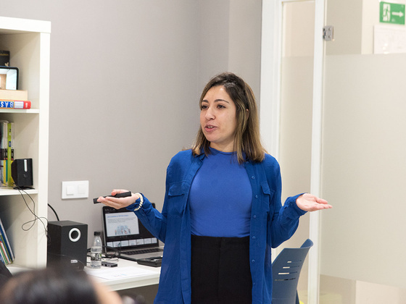
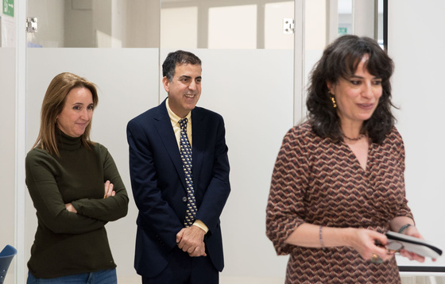
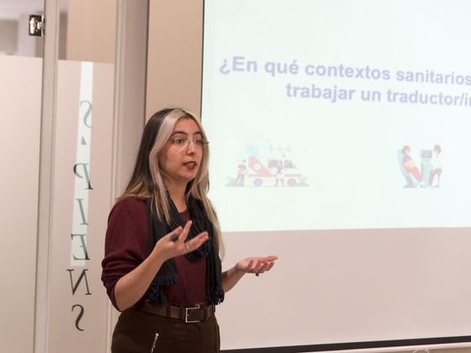
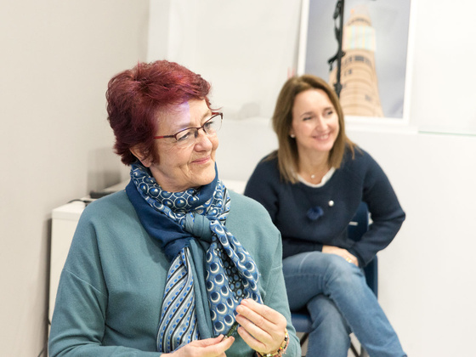
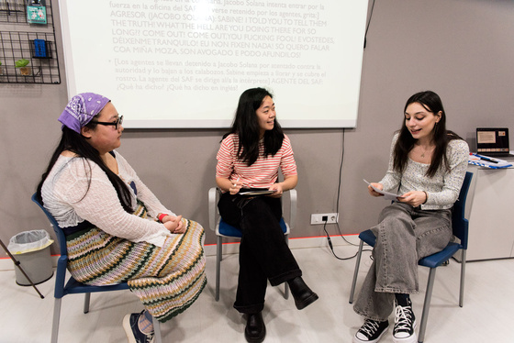
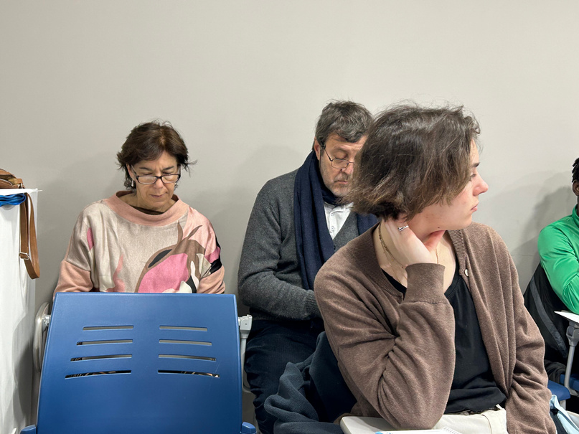
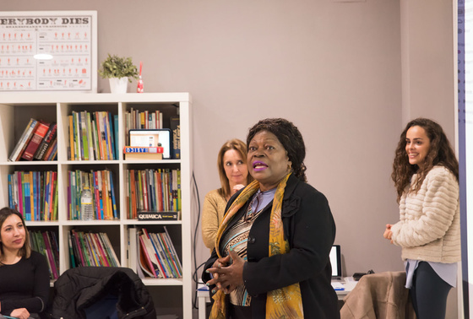
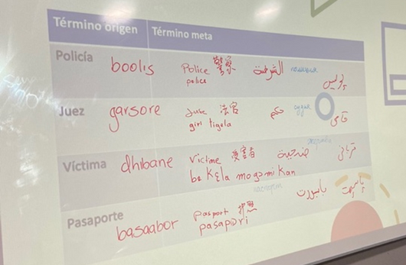

Pilot course
March 2024, Madrid, 6 sessions of 4 hours
Academic trainers (University of Alcalá) + Guest speakers from different institutions working in key areas
University of Alcalá’s official course
certification upon completion.
Activities:
  sight translation
  roleplays
  collaborative glossary
  reflection activities
  assessment activities
Competences:
  Understanding context & setting
  Understanding details of procedures & protocols
  Awareness about cultural sensitive communication
  Recognition of ethical implication withing Public Service settings
  Awareness of the need to conduct themselves professionally to ensure communication and safeguard users’ rights

Slide 19
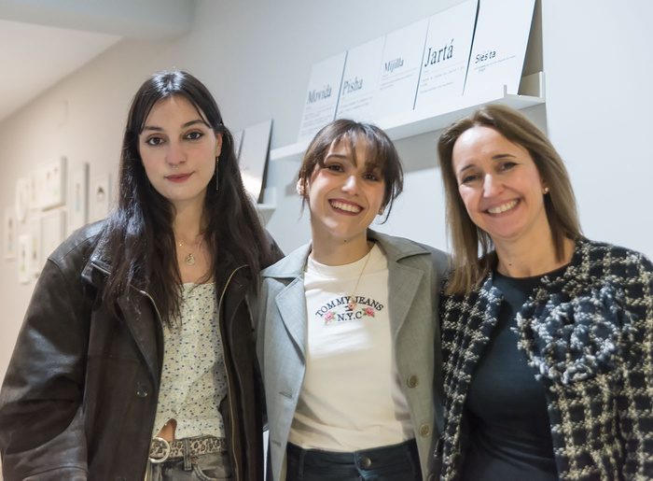
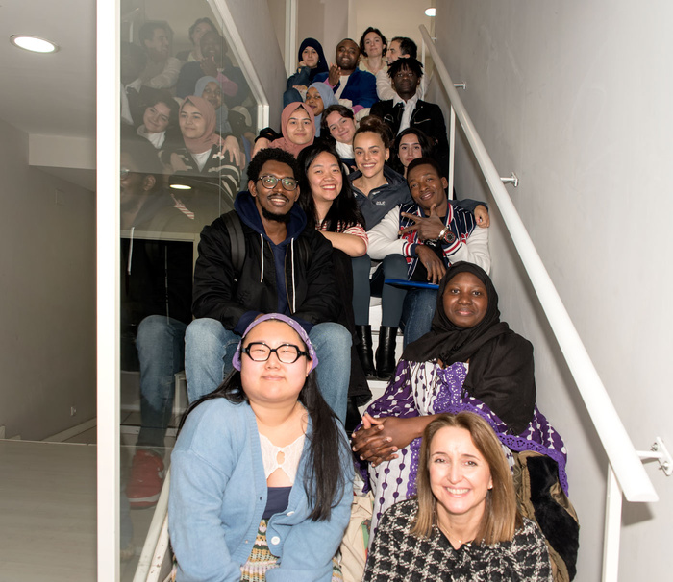
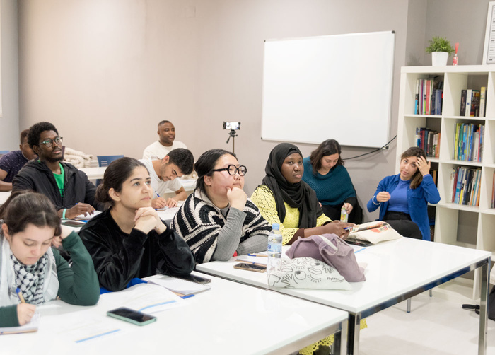
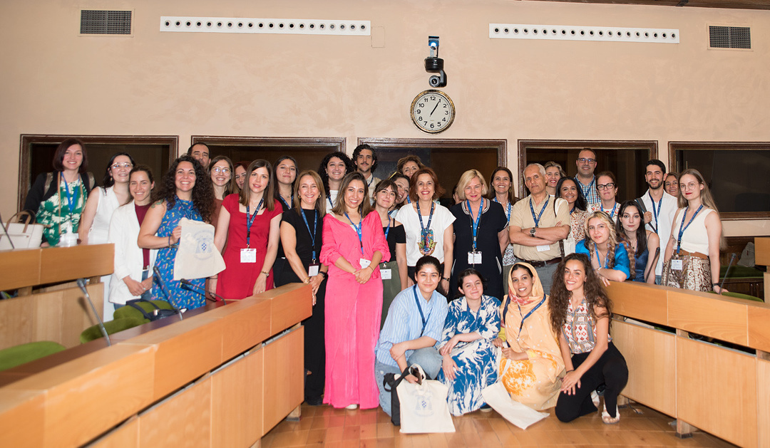
Results from pilot course
  Pilot students provided positive feedback
  Materials were found useful, specially the audiovisual resources
    1st, 2nd and 3rd module were found useful and easy to follow
    Specific thematic modules (4, healthcare and 5, legal-administrative) were considered to be more difficult and specialised. Students considered that more examples and emphasis on key points could be benefitial
  Students who took part have already been hired as PSIT
    starting tools and basic knowledge to follow professional standards

Slide 20


Online course
Steps
ADAPTATION
REORGANIZATION
Of practical activities into audiovisual format
of information and modules when necessary
INTEGRATION
REFLECTION
Through knowledge-check questions at the beginning or end of each module
of cross-referencing to reinforce learning continuity
  iSpring software
  5 modules designed in English:
    introduction
    working fields in PSIT
    PSIT characteristics & modalities
    PSIT in healthcare
    PSIT in legal settings
  Localised for Italy

Slide 21
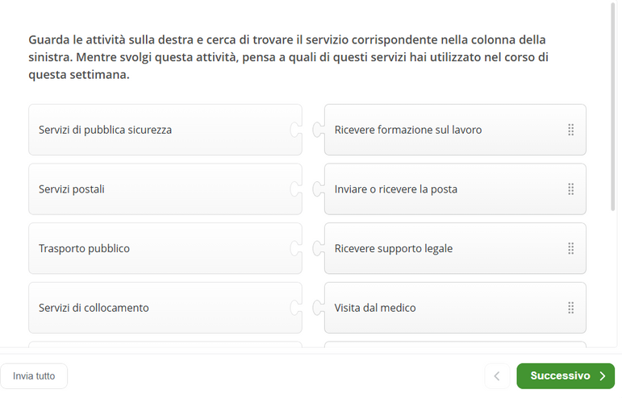
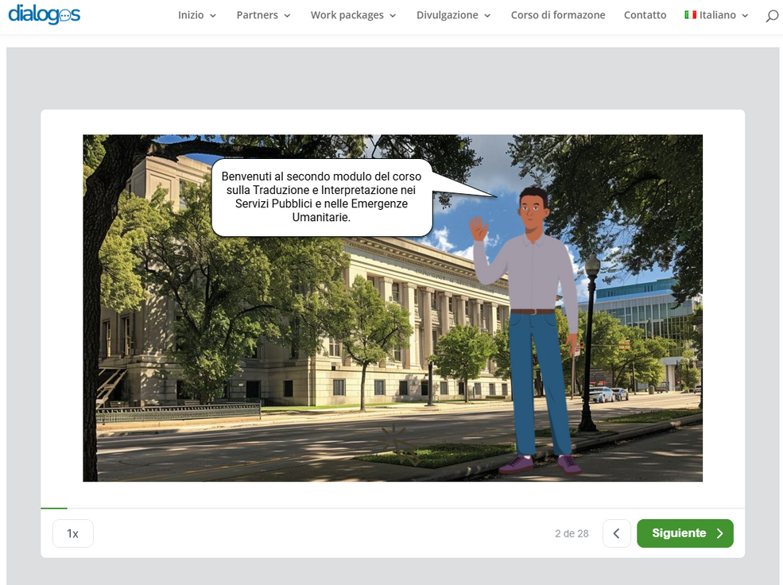
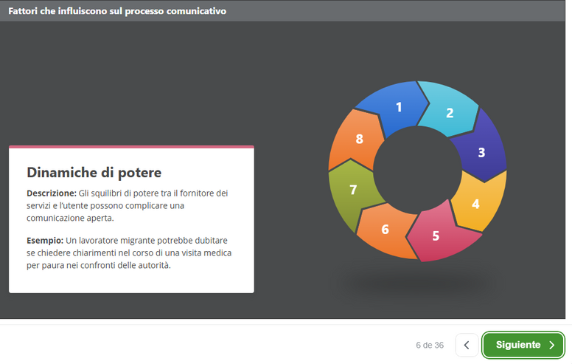
Online course

Slide 22
Online course survey’s results

Slide 23
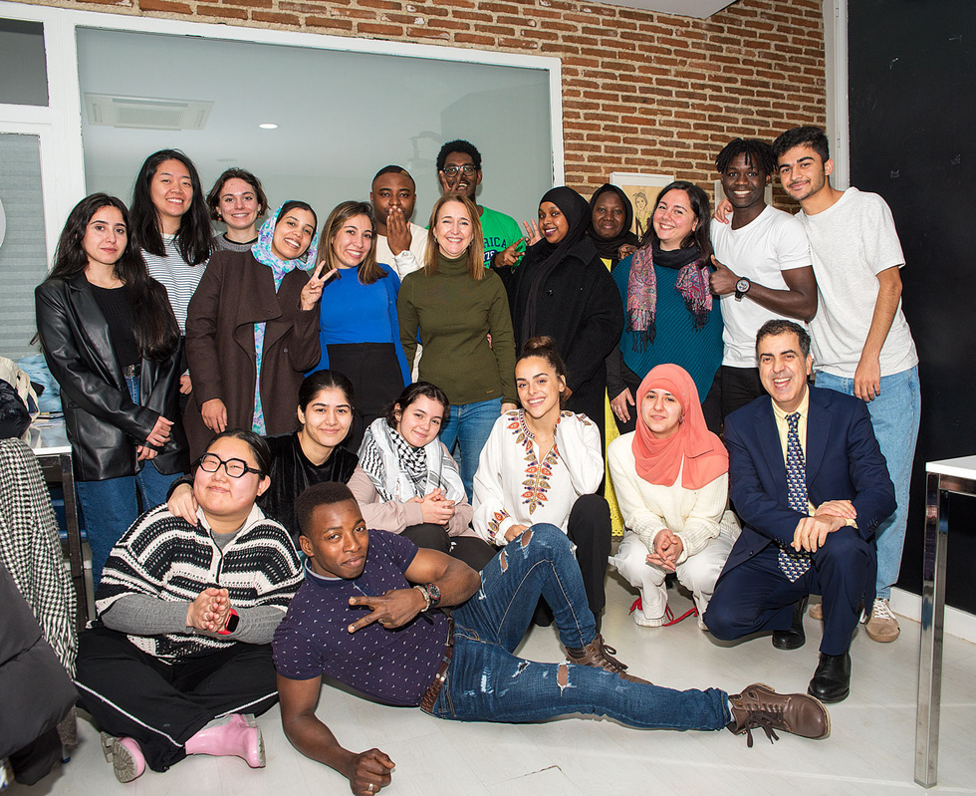
Conclusions & Future steps
  WP2 and 3 have contributed to the identification of linguistic needs, specifically targeted at LLDs in PSIT settings
  The pilot course has helped participants to rapidly acquire basic but fundamental knowledge in PSIT
  The training course could be used to train LLD speakers in crisis situations, enabling them to provide emergency language services and thus, guaranteeing the rights of those in need

Slide 24
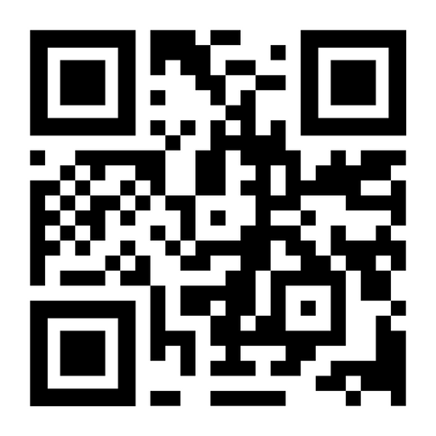



Thank you !
carmen.pena@uah.es
candelas.bayon@uah.es
Website
Instagram
X
https://dialogoserasmus.eu
@dialogoserasmus
@dialogoserasmus

