Slide 1





The project
Carmen Pena
University of Alcalá
https://dialogoserasmus.eu
@dialogoserasmus

Slide 2


1. Introduction: Linguistic assistance & migration
The first landing context for migrants are very frequently Southern Mediterranean countries, which are regarded as gateways into the EU.
Greece, Italy and Spain have specific needs concerning migration.
Multicultural and multilingual professionals should be available to deal with any communication problem that may emerge when delivering urgent medical and administrative assistance upon arrival.

Slide 3

1. Introduction: Linguistic assistance & migration
NGOs, associations and administrations normally turn to ad hoc nonprofessionals that are not trained in intercultural communication, mediation, translation and interpreting.
Communication barriers can hinder integration and equal access to services for migrants. This is especially true for speakers of Languages of Lesser Diffusion (LLDs), who face grater challenges given the lack of support in the form of written information materials, mediation resources, interpreters, etc.

Slide 4
1. Introduction: Linguistic assistance & migration
Hence the need for the Erasmus + project:
Objective: to develop a Public Service Interpreting and Translation (PSIT) training course for LLD speakers, for which there are no training options at present, following EU basic principles regarding diversity and inclusion.

Slide 5






1. Introduction: Linguistic assistance & migration
University of Alcalá
Spain
University of Genoa
Italy
Aristotle University of Thessaloniki
Greece
Abrazando Ilusiones
Spain
San Marcellino Association
Italy
Major Development Agency Thessaloniki
Greece

Slide 6
2. WP2: Networking, mapping, surveys & interviews
Mapping
To map the programs and materials used for PSIT training in the participating countries.
Surveys & interviews
To gather information in terms of current PSIT practices and needs in LLD, and course- related matters, among others.

Slide 7
2. WP2: Networking, mapping, surveys & interviews
Most relevant results
LLD are underrepresented.
Most students in the three participating countries stated that they had never received training in interpreting and/or mediation, although they admitted to having acted as interpreters/mediators for their families or friends to some extent.
Most professionals affirmed having frequent or daily contact with LLD speakers. However, 45.7% in Italy and 57.9% of the respondents in Spain declared that there is no form of mediation services available in their workplace. Conversely, 43.2% of the professionals in Greece state that language mediators are part of the staff where they work.

Slide 8




3. WP3: Material analysis, course design & material creation, piloting & results
Material analysis Results obtained from the mapping task to select those resources and programmes that could be particularly useful for the design of DIALOGOS training course.
Piloting & results
Online training course in the final work package by analysing and assessing the effectivity and usefulness of the materials and methodologies suggested.
Course design & material creation Final contents, making use of some of the materials gathered from the previous task and producing new ones.

Slide 9
3. WP3: Material analysis, course design & material creation, piloting & results
Course design & material creation
Objectives:
  promoting interaction with trainees
  developing practical activities and
  creating an engaging, hands-on learning experience for our PSIT students.
Students’ profile: bilingual and bicultural students that are proficient in at least two languages, one of them being an LLD, and that do not necessarily have university level education, nor a previous background in PSIT.
EMT Competence framework

Slide 10

3. WP3: Material analysis, course design & material creation, piloting & results
Competence-based learning:
Understanding context: crucial for interpreters to convey messages accurately and appropriately between providers and users.
Understanding the specific setting.
Understanding the details of procedures and protocols. Being aware of the importance of cultural background to avoid misunderstandings and ensure culturally sensitive communication.
Recognising the ethical implications within public service settings ensures that interpreters act within professional standards and safeguard users' rights and dignity.

Slide 11
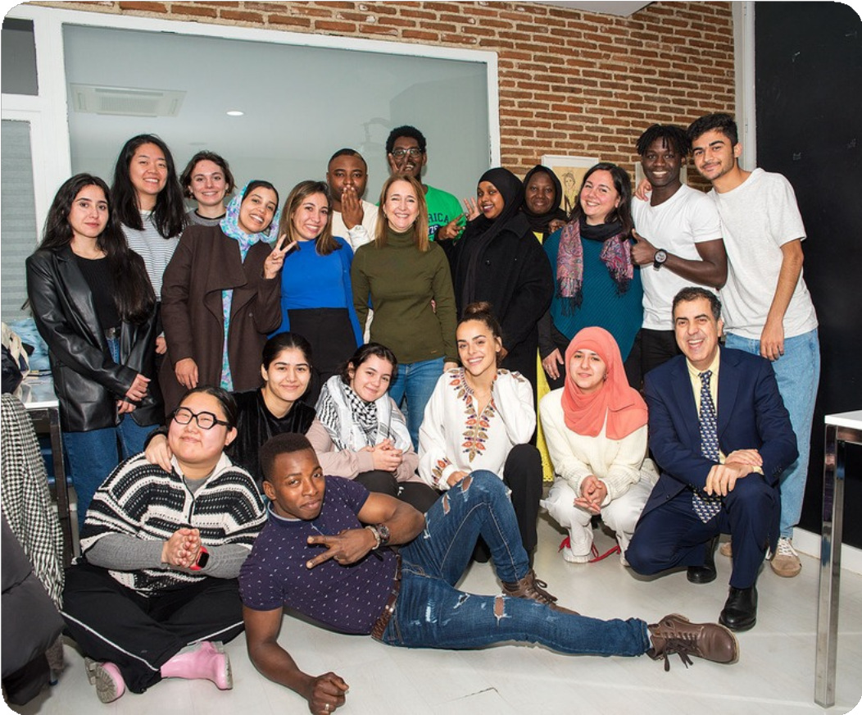
3. WP3: Material analysis, course design & material creation, piloting & results
Piloting & results
The objective of the piloting was to test the materials and methodologies developed and to test if it could easily be applicable in crisis situations that urgently require the use of trained interpreters.
Participants selection
A total of 74 institutions were contacted (they stated that there is a critical need for trained translators and interpreters in Wolof, Bambara, Fula, Swahili, Hausa, Somali, Kinyarwanda, Soninke, Yoruba, Farsi, Armenian and Azari).
17 students that could speak, among others: Amazigh, Arabic (Hasania, Darija), Armenian, Bambara, Bassa, Diula, Chinese (Mandarin + Wu and Northern Eastern dialects), Ewondo, Persian, Poular, Russian, Somali, Swahili and Tamazigh

Slide 12
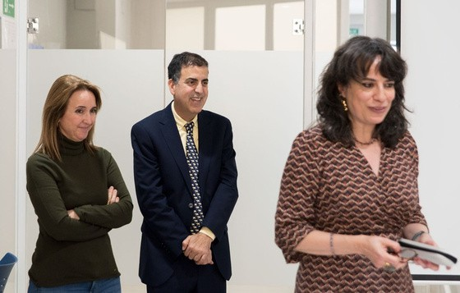
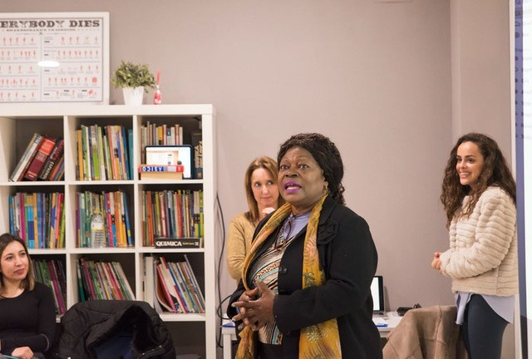
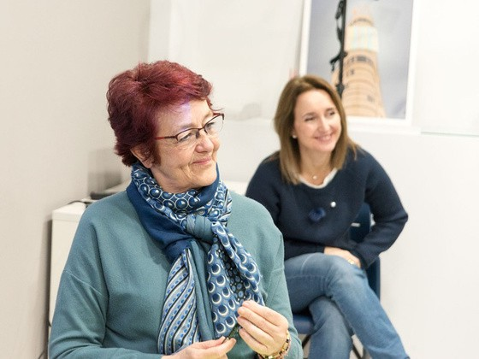

3. WP3: Material analysis, course design & material creation, piloting & results
The onsite pilot course took place in March 2024 in Madrid.
It lasted a total of 6 4-hour-long sessions.
Apart from the academic trainers coming from the University of Alcalá, we received guest speakers from different institutions working in different fields related to DIALOGOS.
Students received a University of Alcalá’s official course
certification upon completion.

Slide 13


3. WP3: Material analysis, course design & material creation, piloting & results
5 MODULES:
Modules 1 and 2
mainly theoretical.
Modules 3, 4 and 5:
mainly practical.
focused on the development of interpreting techniques.
including specific information and vocabulary of the different public services in Spain.

Slide 14
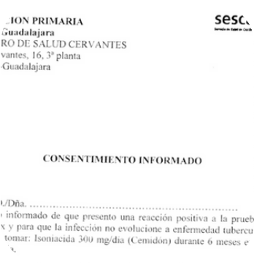
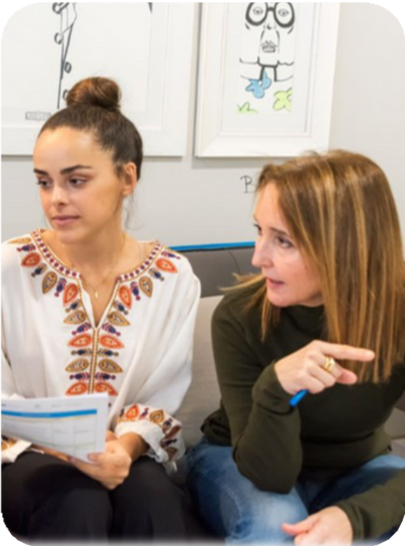
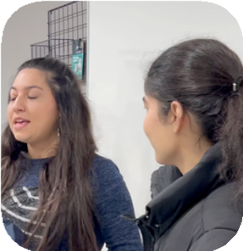
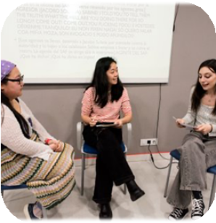
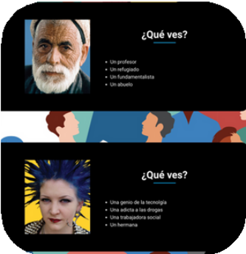
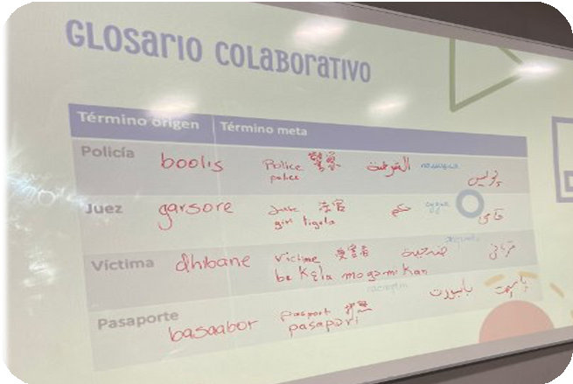
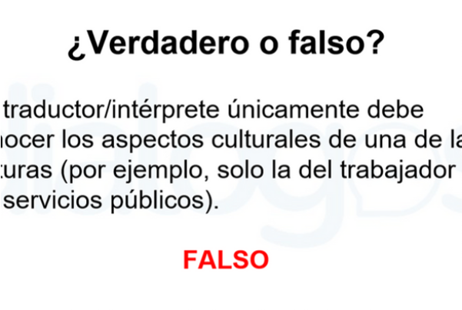
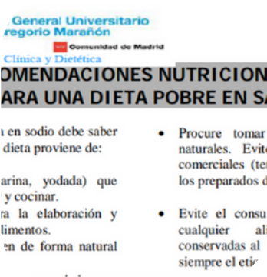
3. WP3: Material analysis, course design & material creation, piloting & results
Examples of activities
Interpreting practice
Reflection activities
Roleplays
Sight translation
Cooperative glossary
Assessment

Slide 15

3. WP3: Results
Students in the onsite pilot course provided very positive feedback.
Trainees found the material very useful, especially the audiovisual resources (this gave way to choosing iSpring as didactic tool).
Concerning the specific thematic modules, 4 (healthcare) and 5 (legal-administrative), they found it difficult to understand specialised terms and concepts.
These thematic modules would need further work.

Slide 16
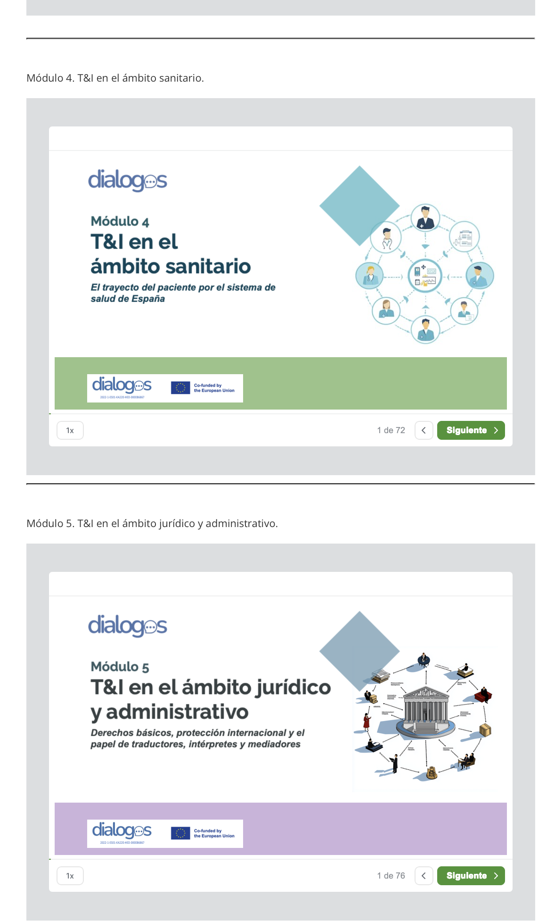
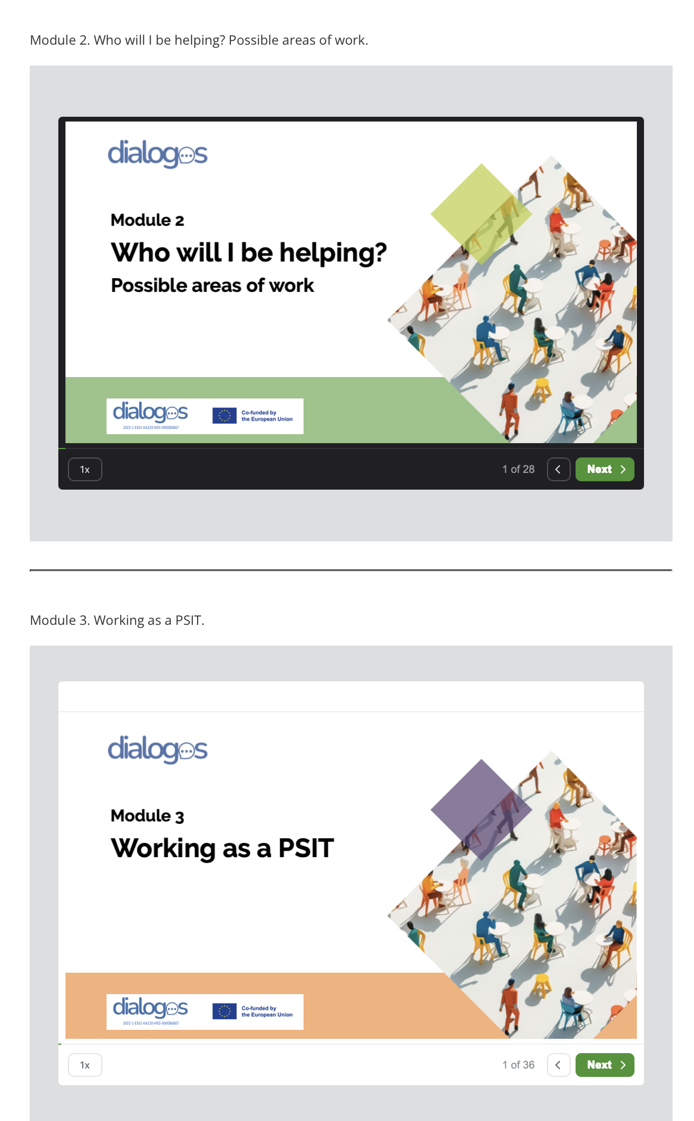

4. WP4: Results www.dialogoserasmus.eu

Slide 17



4. Results: WP4
Theoretical content is presented interactively by virtual avatars that guide trainees through each module.
Information is presented visually and direct access to audiovisual resources is provided to enhance comprehension and achieve meaningful and dynamic learning.
Each lesson is accompanied by interactive activities such as roleplays, quizzes and case studies, and a test is included at the end of each lesson to assess competence acquisition.

Slide 18
4. Results: WP4

Slide 19
5. Conclusions
DIALOGOS project has identified linguistic needs of LLD speakers and created a course which could be rapidly taken to acquire basic but fundamental PSIT indications and practices. Proof of this is that those students who participated in our pilot course have already been hired as PSIT in different language service companies.
We are working now in the adaptation of the course to the online course with iSpring in different languages.
We have already created five modules: 1) introduction, 2) working fields in PSIT, 3) PSIT characteristics and modalities, 4) PSIT in healthcare, and 5) PSIT in legal settings in Spanish (localised) and English (general). Working on Italian and Greek versions.

Slide 20
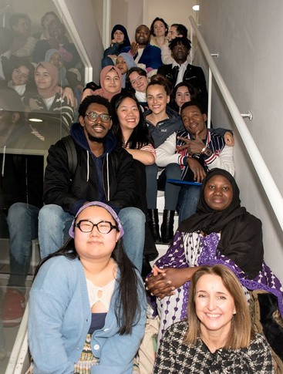
5. Conclusions
We hope the number of DIALOGOS trainees working in PSIT keeps rising, helping migrants to access public services and exercise their basic rights.

Slide 21


Thank you!
https://dialogoserasmus.eu
@dialogoserasmus @dialogoserasmus
Carmen Pena carmen.pena@uah.es

